Slide 1




ELECTRONICS SALES ANALYSIS
Adithya Venkatramanan
Ha Tran
Novemeber 25th, 2024

Slide 2

CONTENTS
01 - Introduction
02 - Data
03 - Data Wrangling
04 - Preliminary Analysis
05 - Modeling
06 - Conclusions

Slide 3

01 - INTRODUCTION
"Black Friday is coming!!!!!!!!!"
An electronics company wants to make a plan for the upcoming Black Friday. As employees in the company’s data team, we need to analyze the sales data from the last fiscal year to provide the stakeholders with enough information to make data-driven decisions.

Slide 4

02 - DATA
"Let’s talk about our data!"
Data Source: Kaggle
Size: 20000 rows and 16 columns
Main variables: Customer ID, Age, Gender, Loyalty Member, Product Type, SKU, Rating, Order Status, Payment Method, Total Price, Unit Price, Quantity, Purchase Date, Shipping Type, Add-ons Purchased, Add-on Total
Time frame: 09/2023-09/2024

Slide 5


03 - DATA WRANGLING
Although our raw data was not significantly off, we still needed to handle missing data and calculate new variables.
"Let’s clean the data!"

Slide 6
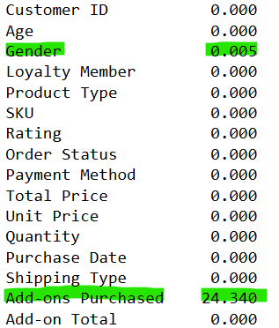
03 - DATA WRANGLING
Gender: We imputed the missing values by randomly assigning “Male” or “Female” based on their calculated probabilities.
Add-ons Purchased: We replaced null values with a default value “None”.

Slide 7
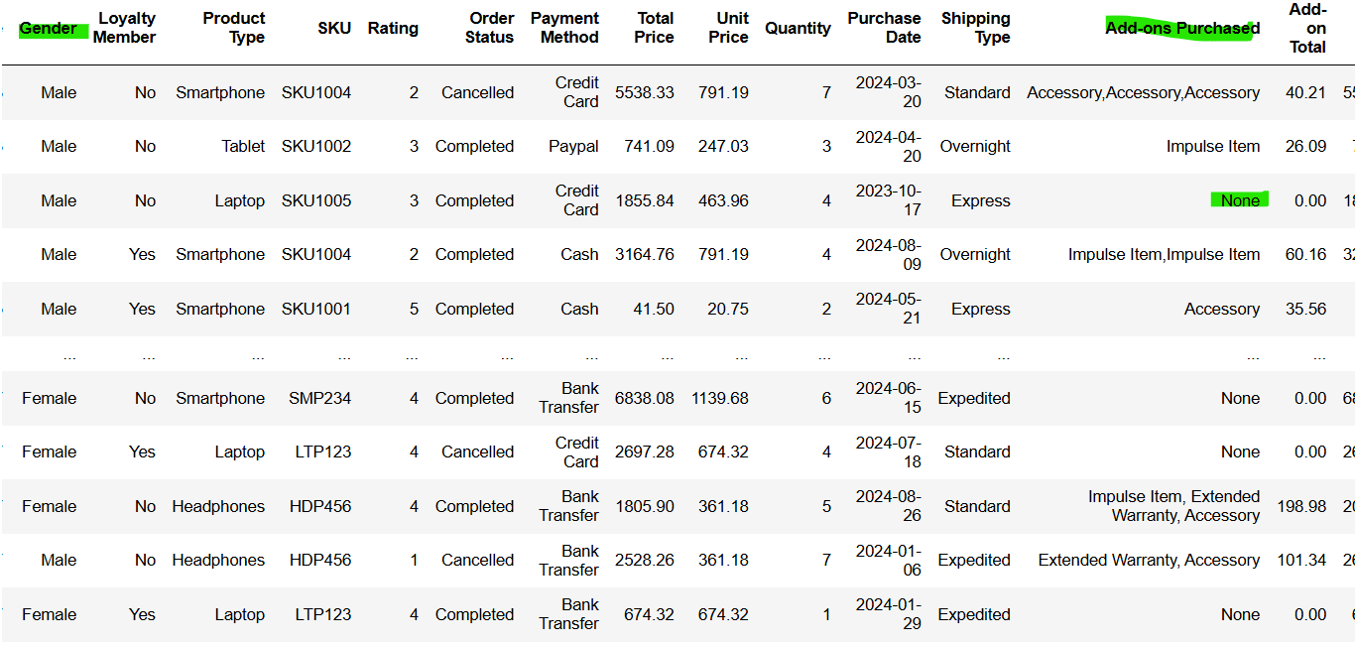
03 - DATA WRANGLING
RESULTS

Slide 8
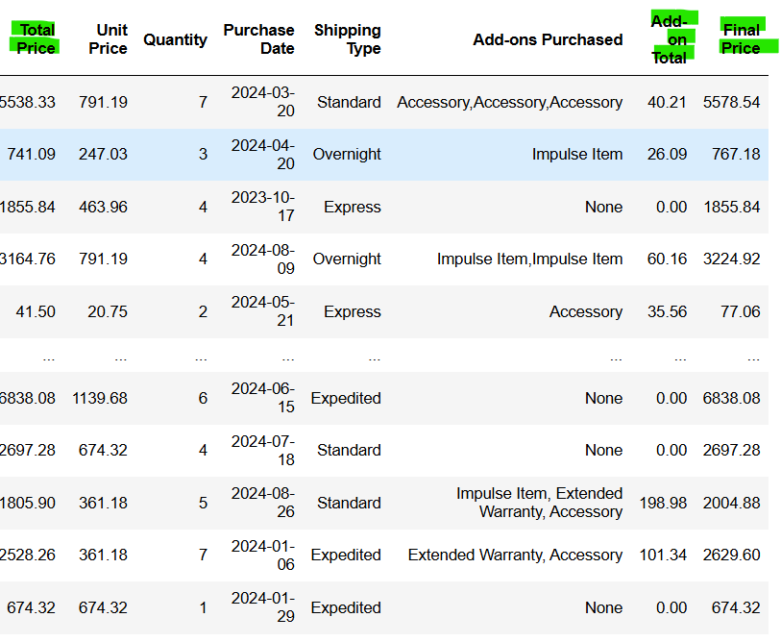
03 - DATA WRANGLING
As people could still buy add-ons, the total price didn't reflect the total revenue. Therefore, we calculated a new column called "Final Price".
Final Price = Total Price + Add-on total

Slide 9
04 - PRELIMINARY ANALYSIS
01 - Summary statistics
02 -Correlations
03 - Visual inspections

Slide 10
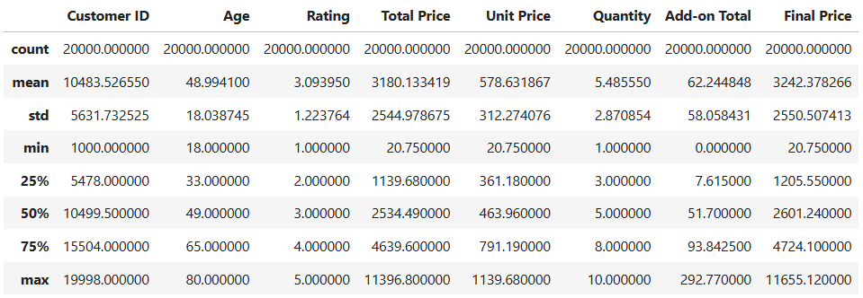
04 - PRELIMINARY ANALYSIS
01 - Summary statistics

Slide 11
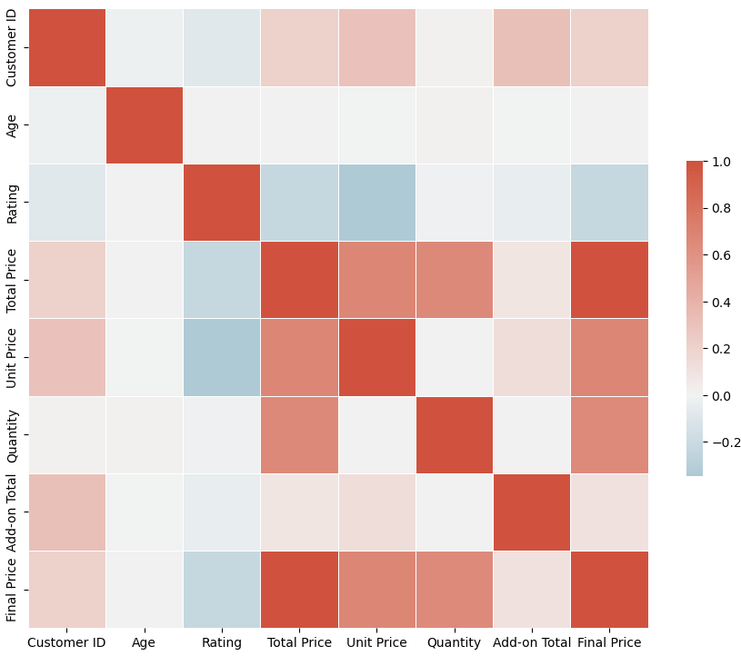
04 - PRELIMINARY ANALYSIS
02 -Correlations
Red=Positive Correlation (Direct Relationship)
Blue=Negative Correlation (Inverse Relationship)
White=No correlation
FINAL PRICE
Strong positive correlation with Total Price and Quantity
Negative correlation with Rating
Little to no correlation with other variables.

Slide 12
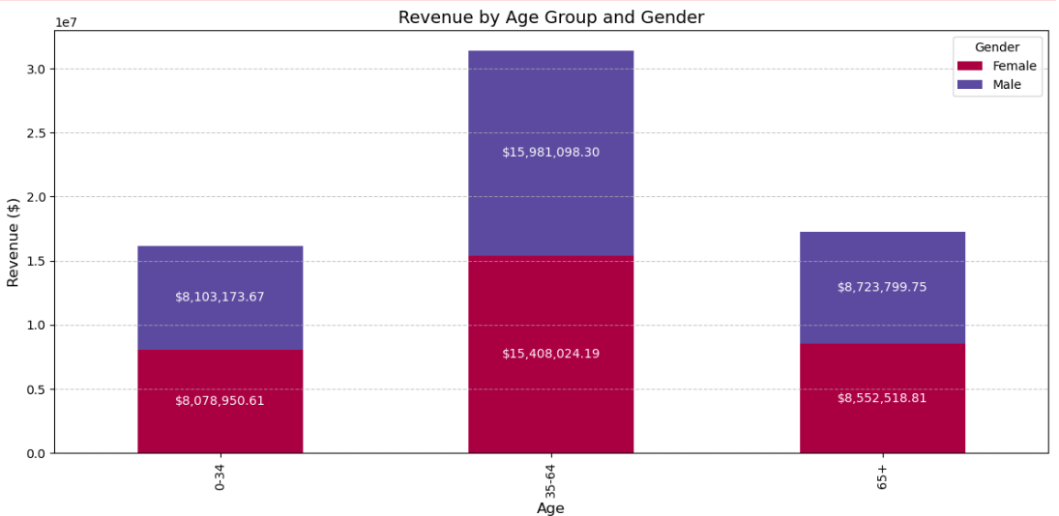
04 - PRELIMINARY ANALYSIS
03 - Visual inspections
Male customers in three age groups spent more money on electronics products than the others.
People in the middle age group (35-64) contributed more to the company's revenue than the other age groups.

Slide 13
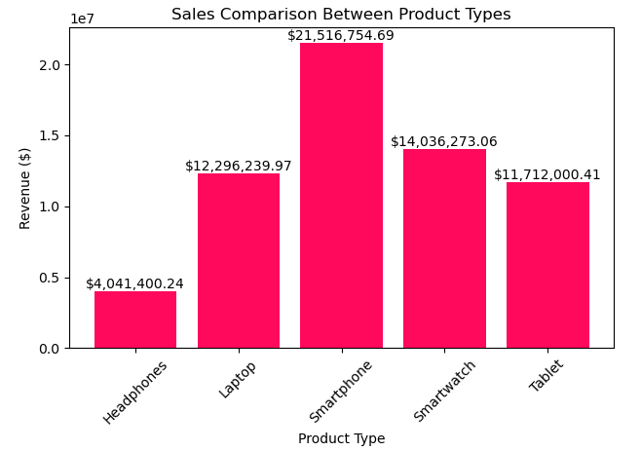
04 - PRELIMINARY ANALYSIS
03 - Visual inspections
While smartphones were bought the most, with around $21,500,000 in revenue, headphones were the least sold product, with around $4,000,000 in revenue.

Slide 14
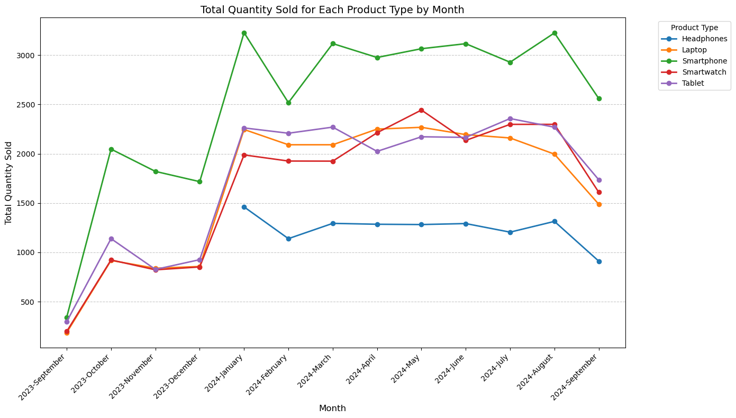
04 - PRELIMINARY ANALYSIS
03 - Visual inspections
Smartphones peaked in October 2023 and consistently outperformed other products.
Sales spiked in late 2023, likely due to holidays, then declined by mid-2024.

Slide 15
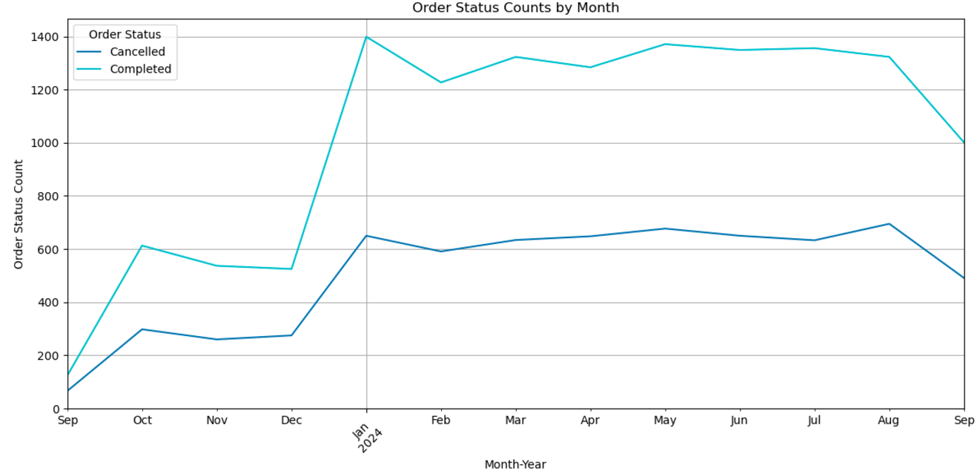
04 - PRELIMINARY ANALYSIS
03 - Visual inspections
While the number of orders completed peaked in January 2024 (around 1400 orders), the figure for orders canceled was highest during August 2024 (around 700 orders).

Slide 16
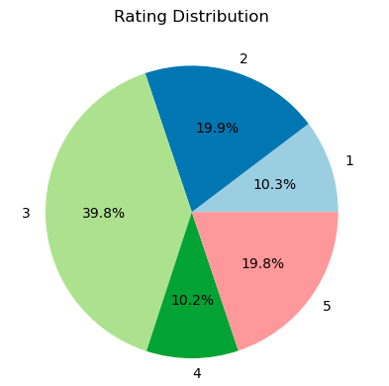
04 - PRELIMINARY ANALYSIS
03 - Visual inspections
The majority of the orders received 3 stars (39.8%), tailed by 2 stars (19.9%) and 5 stars (19.8%).
1 star and 4 stars were the least common, making up 10.3% and 10.2%, respectively,suggesting a tendency toward moderate feedback.
While 69.8% of the orders received 3+ stars, 30.2% of them got below 3 stars.

Slide 17
05 - MODELING
01
Non-numeric Feature
02
Feature Creation
03
Train and Test
04
Model Training
05
Predict
06
Evaluate

Slide 18
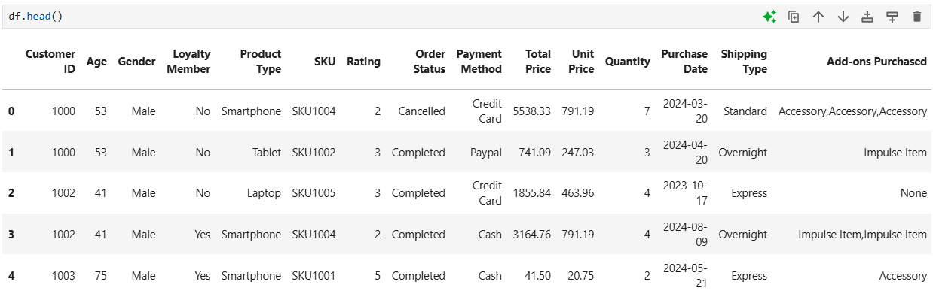
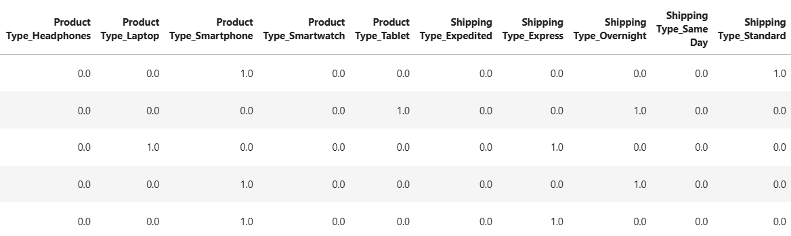
05 - MODELING
01-Non-numeric Feature

Slide 19
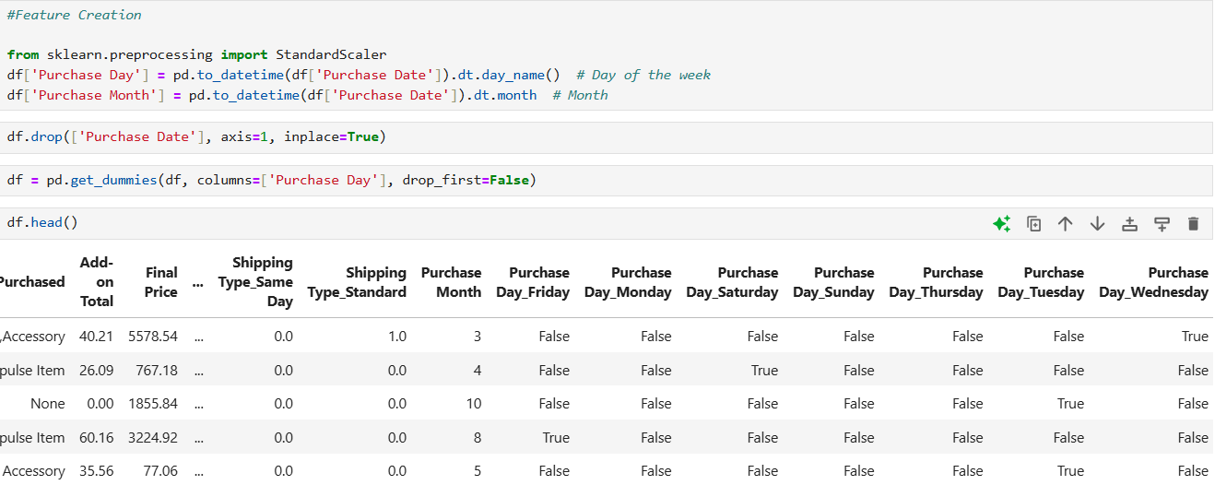
05 - MODELING
02 - Feature Creation

Slide 20
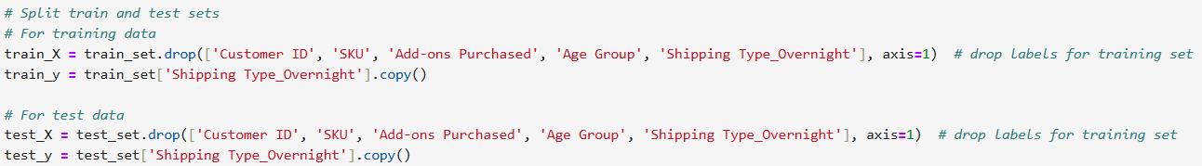
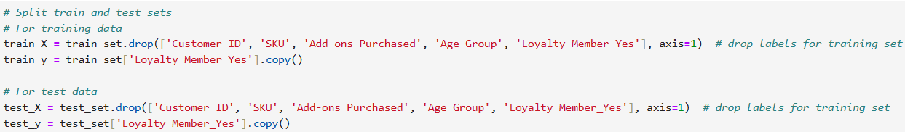
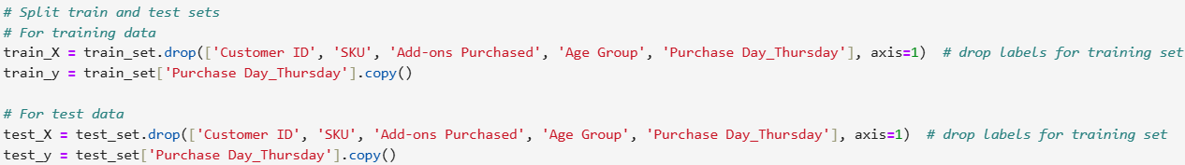
05 - MODELING
03 - What are we training and testing?

Slide 21
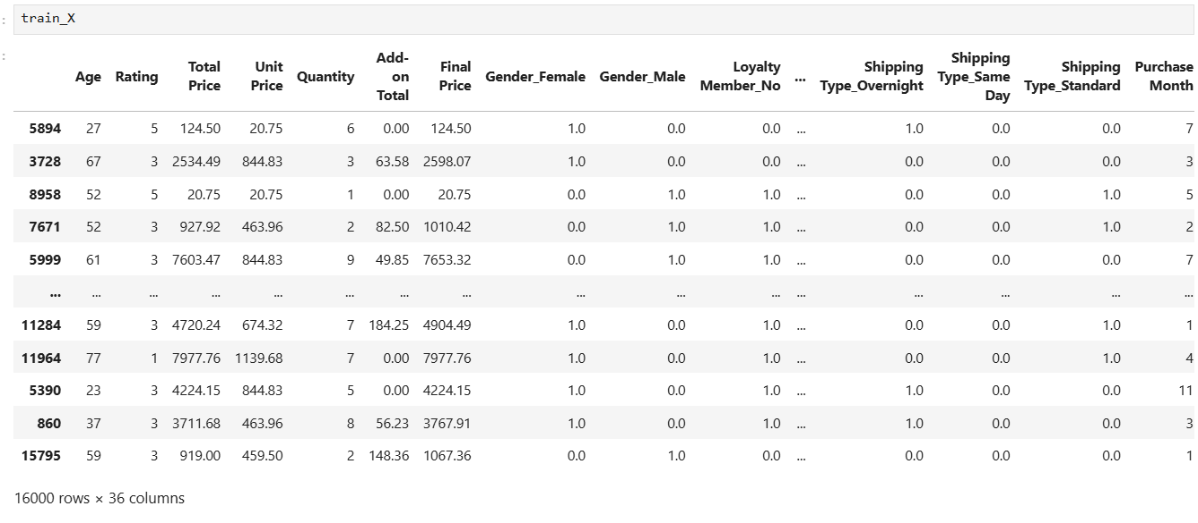
05 - MODELING
03 - Train and Test

Slide 22
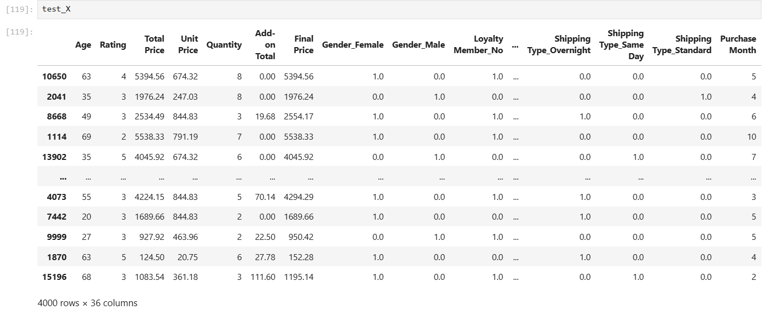
05 - MODELING
03 - Train and Test

Slide 23
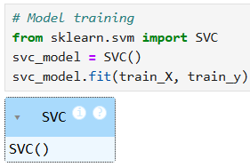
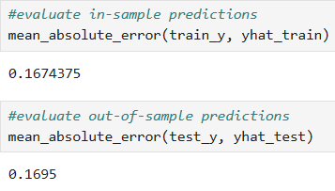

05 - MODELING [SHIPPING TYPE]
04
Model Training
06
Evaluate
05
Predict

Slide 24
05 - MODELING [SHIPPING TYPE]
Interpretation of Results
Our goal was to see if we can predict if a customer will opt for overnight shipping
The mean absolute error is approximately 0.17 which indicates that our model can predict 83% of the times if a customer will opt for overnight shipping.
We can use this information to further offer shipping incentives to select customers who are likely to opt for overnight shipping
The testing MAE is slightly higher than the training MAE which indicates that our model isn’t overfitting

Slide 25
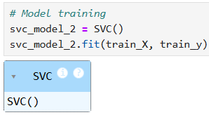
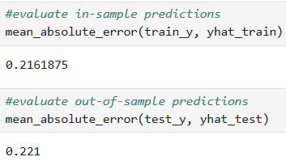

05 - MODELING [LOYALTY MEMBER]
04
Model Training
06
Evaluate
05
Predict

Slide 26
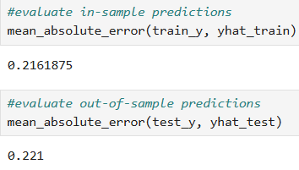
05 - MODELING [LOYALTY MEMBER]
Interpretation of Results
Our goal was to see if we can predict if a customer who shops at our store is already a loyalty member.
The mean absolute error is approximately 0.22 which indicates that our model can predict 78% of the times if the customer is shopping as a loyalty member.
We can use this information to incentivize selected customers to join our loyalty program at a discounted rate before checkout.
The testing MAE is slightly higher than the training MAE which indicates that our model isn’t overfitting

Slide 27
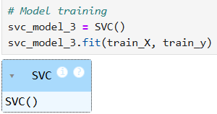
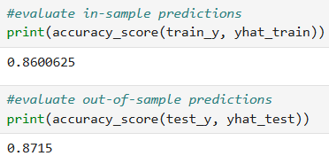

05 - MODELING [DAY OF WEEK]
04
Model Training
06
Evaluate
05
Predict

Slide 28
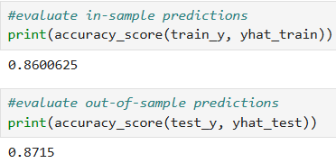
05 - MODELING [DAY OF WEEK]
Interpretation of Results
Our goal was to see if we can measure the likelihood of customers shopping on a Thursday
The accuracy score is approximately 0.86 which indicates that our model can predict 86% of the times if a customer will shop on a Thursday.
The testing MAE is slightly higher than the training MAE which indicates that our model isn’t overfitting

Slide 29
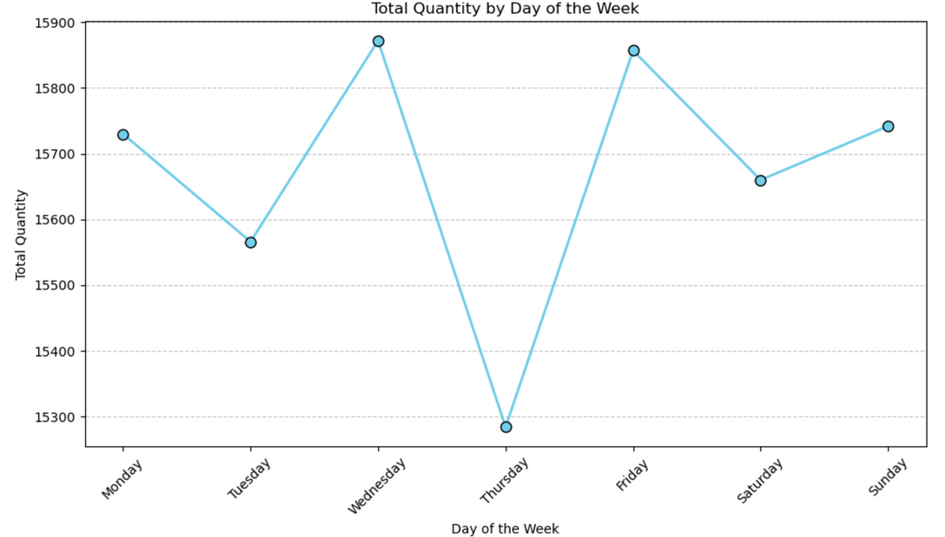
06 - DAY OF WEEK CONCLUSION
Interpretation of Results
What is the objective?
Since our model predicts that there is an 87% likelihood of customers shopping on Thursdays, we should introduce discounts and ensure adequate inventory for sales on Thursdays to push our sales numbers higher.

Slide 30

06 - CONCLUSIONS
Our primary target audience consists of middle-aged individuals. Moreover, male customers have demonstrated greater interest in purchasing our products than other demographics, so they may represent a significant potential customer segment.
We should focus on increasing the sales of smartphones, as they are the most profitable product type.
We have the capability to predict which customers may be interested in overnight shipping and incentivize selected customers to join our loyalty program.
Our sales have dropped particularly on Thursdays while 87% of our customers are still likely to shop on Thursdays. Thus, we need to collaborate with our deals team and inventory team to investigate this further.

Slide 31


